Slide 1
Intel/OSCN Statewide Efforts
Notes:
Ohio Semiconductor Collaboration Network (OSCN): Pathways and Upskilling - Delve into the Ohio Semiconductor Collaboration Network (OSCN) and discover how this initiative is aligning education with industry needs. Learn about pathways, upskilling opportunities, and how you can get involved at multiple levels to support Ohio’s semiconductor industry.

Slide 2
Ohio Semiconductor Collaboration Network and Curriculum Development

Slide 3
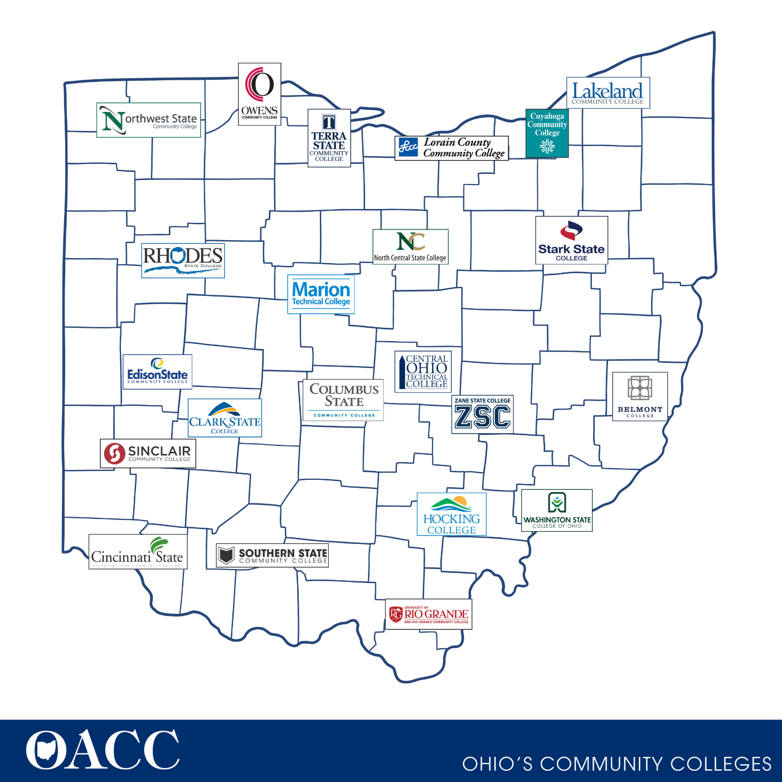
Ohio community Colleges
“Community colleges play a critical role in workforce development across the nation. They have a broad mission to provide academic programming and skills training to prepare students for jobs or to transfer to four-year colleges and universities. In order to access and make effective use of community colleges’ training resources, many workers, particularly those with low-incomes and family responsibilities, need services and supports that go beyond what a college typically provides.” Aspen Institute

Slide 4
Ohio Semiconductor Collaboration Network

Slide 5
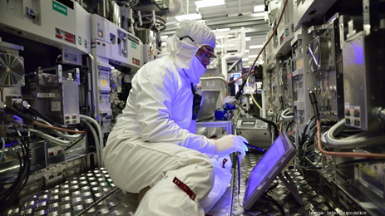
Ohio Semiconductor Collaboration Network
Statewide collaborative focused on building and sustaining a strong semiconductor technician pipeline by aligning credentialing and program outcomes, scaling best practice and leveraging partnerships
Steering Committee formed to create a sustainability strategy for the network, support grant Key Topic achievement and align work to the broader Advanced Manufacturing ecosystem in Ohio​
Steering Committee members include the OACC, Community and Technical College Presidents and EVP's, leaders of Ohio economic and workforce development entities such as JobsOhio, The Ohio Manufacturers Association, One Columbus and OhioTechNet

Slide 6
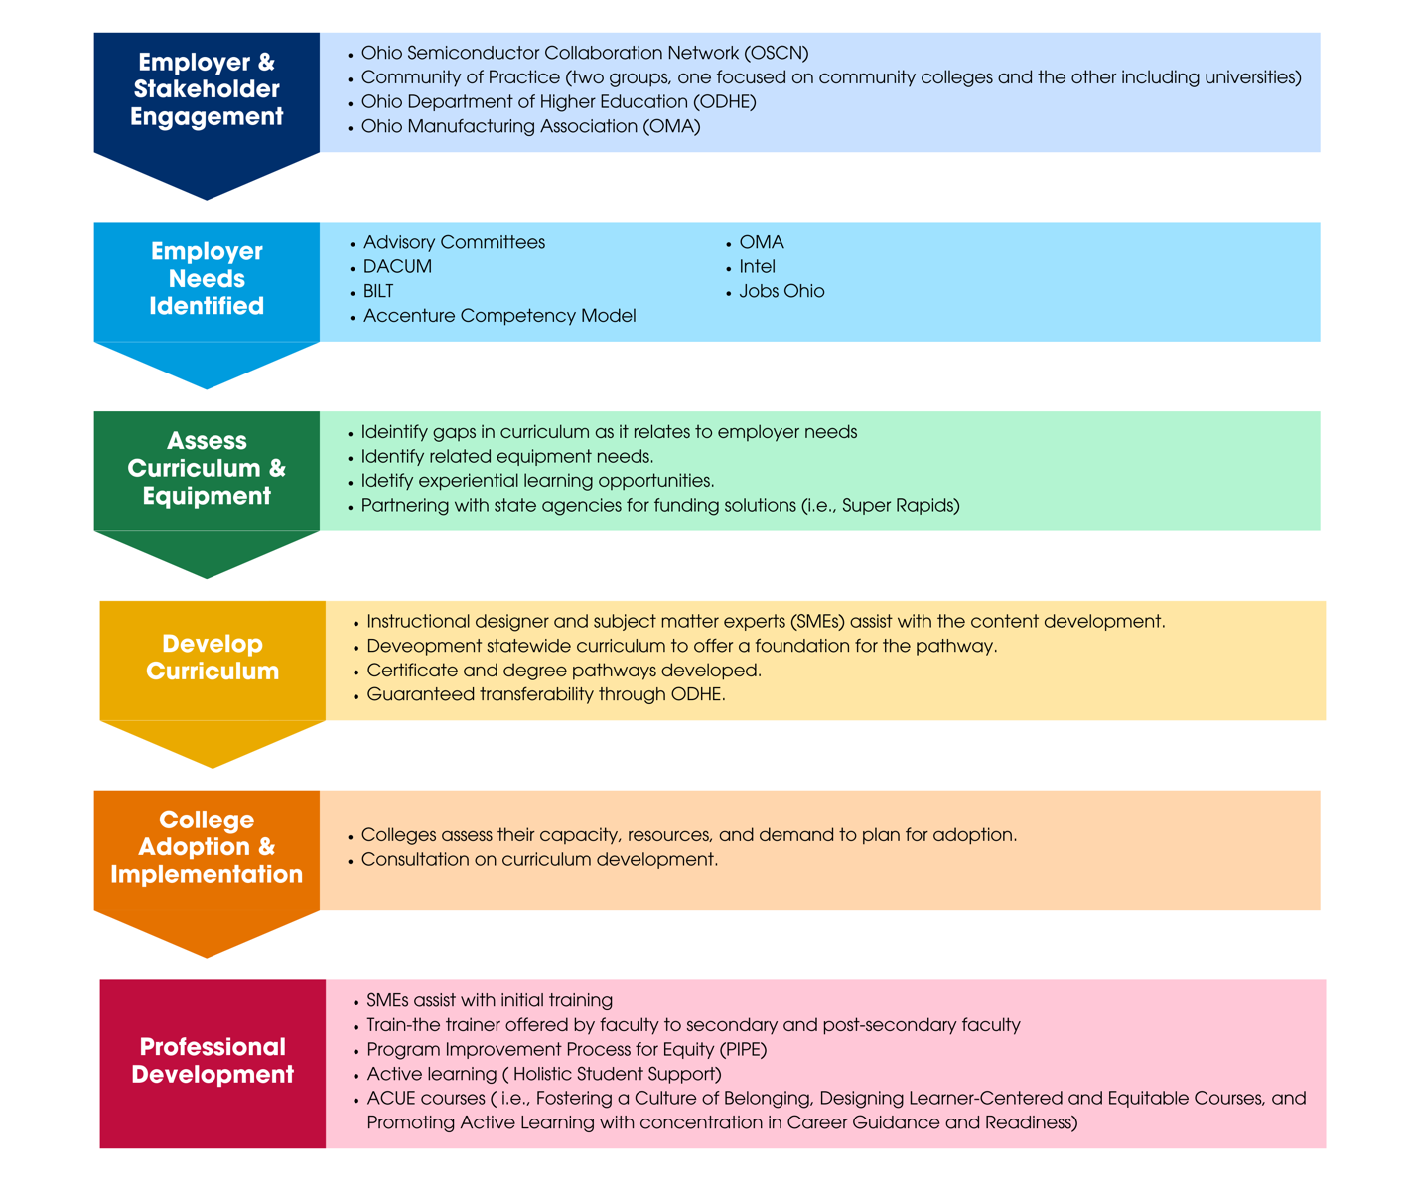
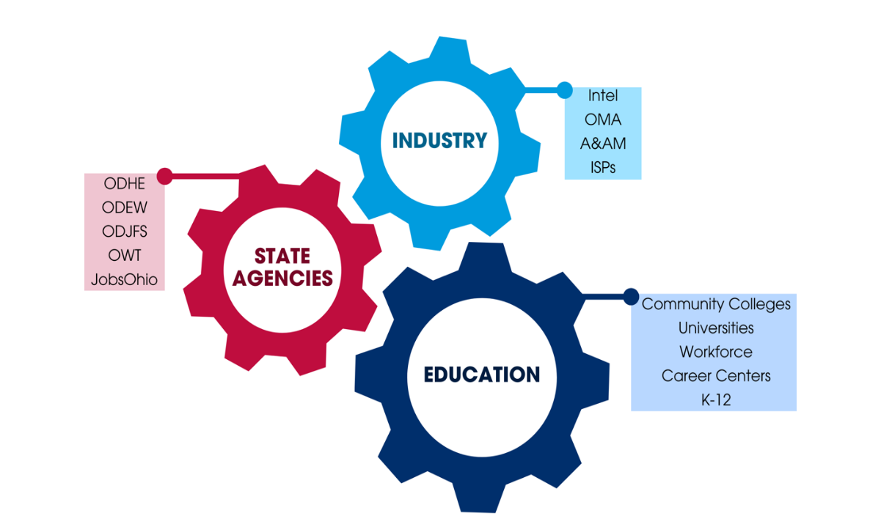
Developing the Ecosystem

Slide 7
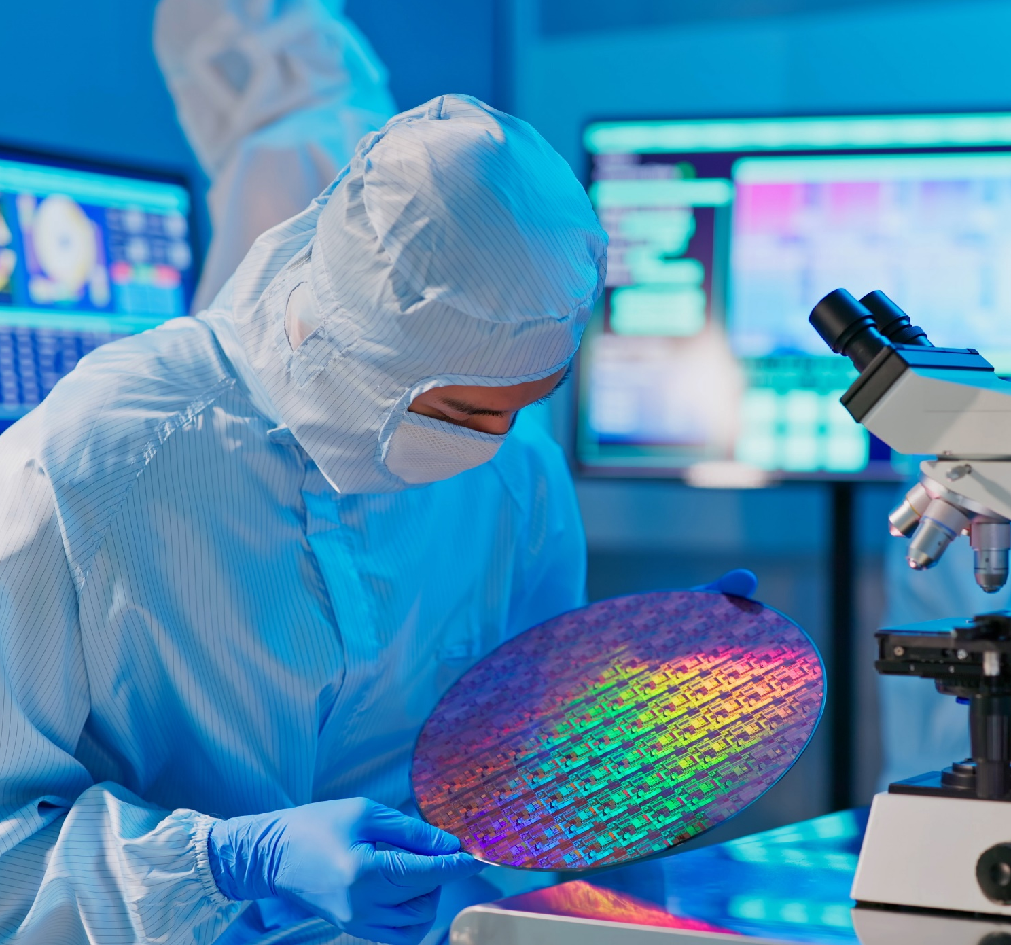
Two-Semester Certificate Grows the Talent Pipeline by:
Preparing people for Operator, Entry-Level Technician roles
Embedding Applied Math & Career Exploration
Facilitating structured cohort models with wraparound support
Allowing returning students to take targeted coursework, avoiding lost credits
Preparing people for working in a cleanroom; wearing a bunnysuit
Introducing Chemical and Cleanroom Safety
Introducing the use of Standard Operating Procedures, working from digital checklists
Notes:
Speaker Notes:
Reducing barriers by not having pre-req math/science and embedding content in a contextualized manner
Gives students early experiential learning by getting them into bunny suits early and hands on with tools.
Adaptable lab model allows schools to scale adoption to fit their own institutional resources: Low Tech > High Tech Labs.
Image Sources:
CSCC Adobe Stock License Image: AdobeStock_431031722
Logos: CSCC

Slide 8
Statewide Ohio Community and Technical College Faculty team partner with Intel to identify courses - January 2023
Proposed One Year Certificate Topics / Coursework
Semiconductor 101 | Introduction to Manufacturing | Vacuum Systems | Electrical Basics (AC/DC)
Digital and Computer Literacy | Hand Tool Basics | Basic Schematics | Pneumatics and Hydraulics
Basic Math -Arithmetic -Measurements -Lower-Level Algebra | Mechanical Systems
New Course Topics
KT1 Activity
Oct '22 -Statewide Curriculum team formed through nomination process (seven faculty / two Instructional designers)
Dec '22 - Held initial Knowledge, Skills and abilities work session w/Intel SME's identifying topic areas and KSA details – "3 new topic areas"
Jan '23 Created working teams for new topic areas to define learning objectives with weekly meeting updates
Held meeting with ODHE leadership to discuss plan for 1- Year certificate and Associates degree approval process
Launched Equity Professional Development –Community of Practice, Cohort micro-courses and NAPE STEM career framework

Slide 9
Courses Available on Ohio LINK
Vacuum Systems: https://ohiolink.oercommons.org/courseware/lesson/2709
OACC Semiconductor 101: https://ohiolink.oercommons.org/courseware/lesson/2706
OACC Introduction to Manufacturing: https://ohiolink.oercommons.org/courseware/lesson/2708
Advanced Manufacturing Competency Model
This project is well tied to Industry
Curriculum needs for Electric Vehicle manufacturing, Aerospace & Defense, Semiconductors, & Industrial Products
Cross walked ODEW’s Career-Tech Standards, ODHE’s Intro to Manufacturing, & SME’s Certified Manufacturing Associate Certification
ODHE
Introduction to Semiconductors for STEM Majors is being developed for TAG approval
Surveys are out now and due back in early December

Slide 10
Sample Advanced Manufacturing Pathway
One Year Certificate
Semiconductor 101
Associate of Applied Science
PLC’s
Industrial Instrumentation and Control
Smart Automation Systems
Lean Six Sigma
Industrial Internet of Things
Quality Systems
Solidworks*
Industrial Robotics Calculus
Gen-eds
Introduction to Manufacturing
Vacuum Systems
Electrical Basics(AC/DC)*
Digital and Computer Literacy
Hand Tool Basics
Basic Schematics
Fluid Mechanics*
Basic Math
Mechanical Systems
Robotics
Data Acquisition Systems
Composition*
Technical Writing
Bachelor of Applied Science*
Semiconductor Mfg. Processes
Manufacturing Processing*
Engineering Materials*
Engineering Statistics*
Physics
Gen-eds
CAD*
Digital systems*
*Indicate existing TAG Courses
Courses in Italics indicate existing/prospective CCP Courses

Slide 11
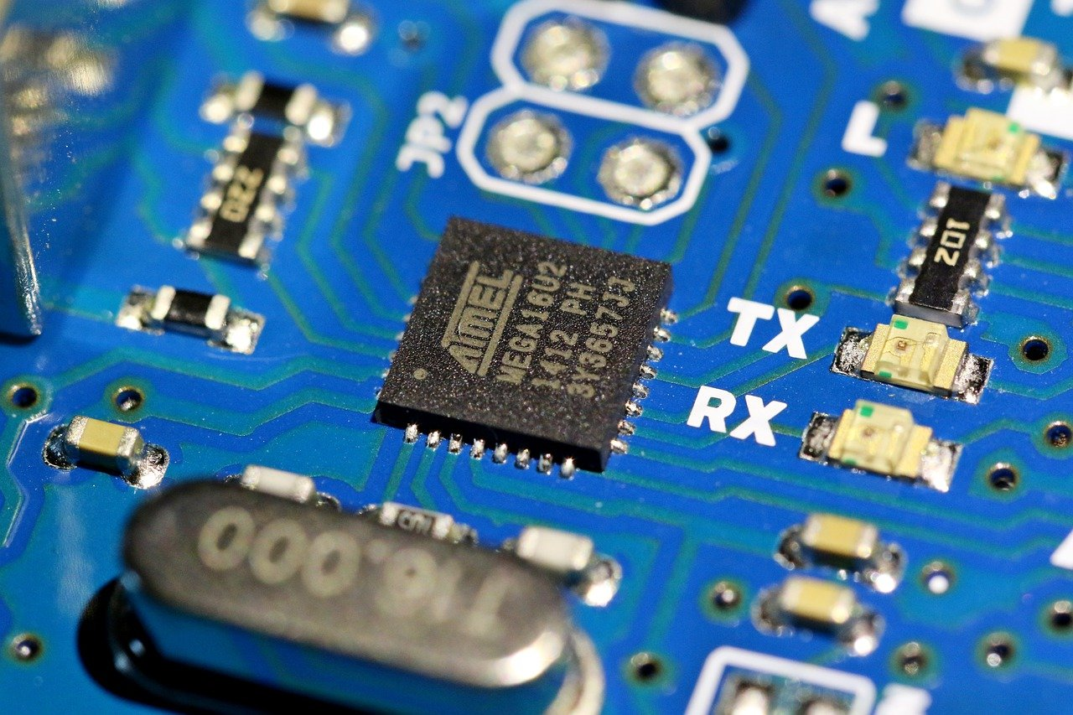
Breakdown of Curriculum Resources
All course content are posted on OhioLink
Syllabi
Presentation Slides with Lecture Notes
Quizzes, Tests, and Knowledge Checks
Lesson Plans
Learning Activities/Assignments
Lab Activities and SOPs
Courses are available in 16 week and 8 weeks versions.
Common Cartridge for integration into Canvas, Blackboard, or other LMS’s are available on Ohio Link

Slide 12
Recruitment, Retention, and Student Success

Slide 13
We need to 8x Completions Across All Ohio Schools to Fill +16k New Jobs 2025 Number of Engineering & Related Associate Degrees and 1-Year Certificates (excludes short term certificates)
8x
+
4x
~
~
Source: ODHE, 2023 CAO Curriculum Survey

Slide 14
Target Audience for these Programs
Populations historically not participating in STEM
Interested, but did not list a STEM role as their first choice
CCP
Non-traditional students
Program Improvement Process for Equity (PIPE)- Women in STEM
Career Changers

Slide 15
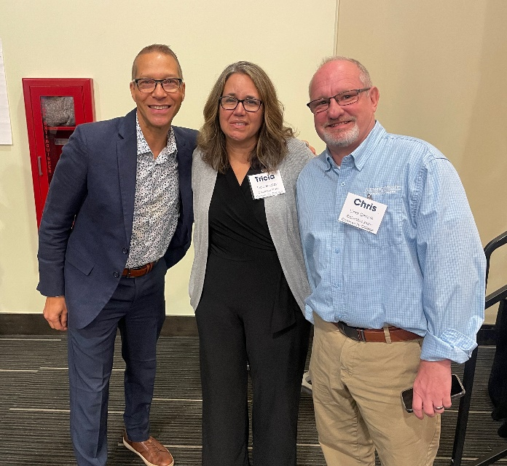
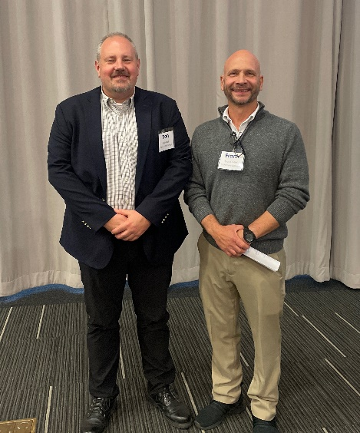
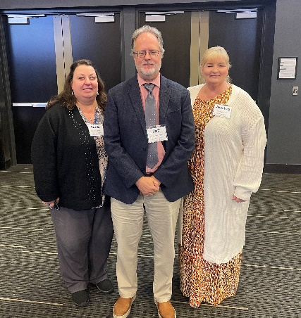
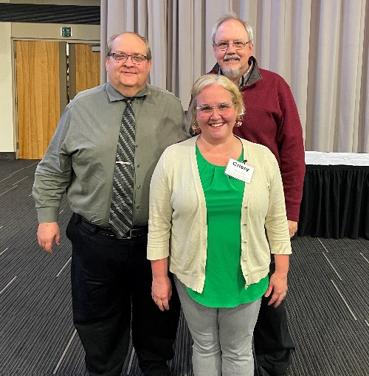
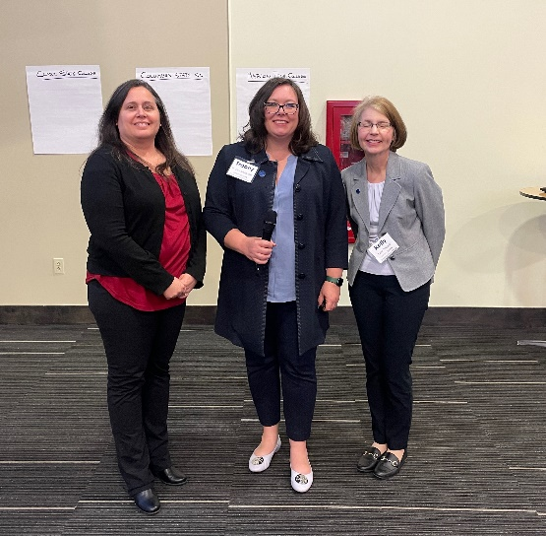
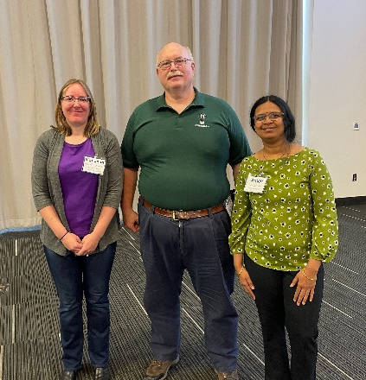
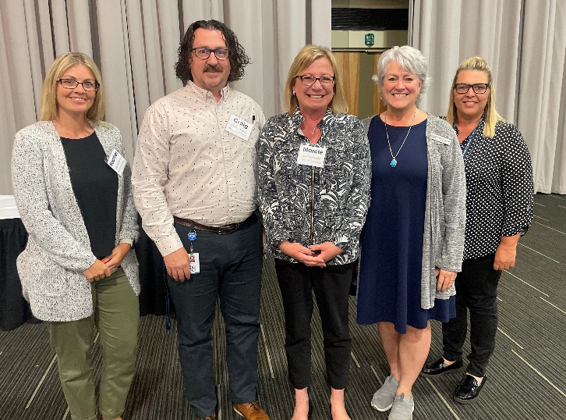
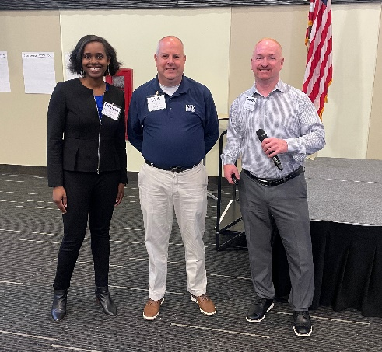
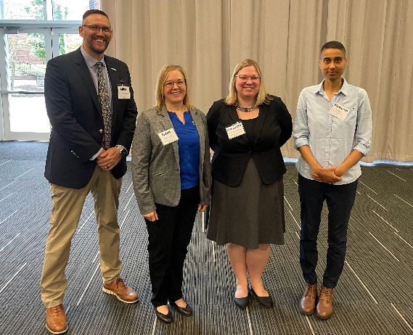
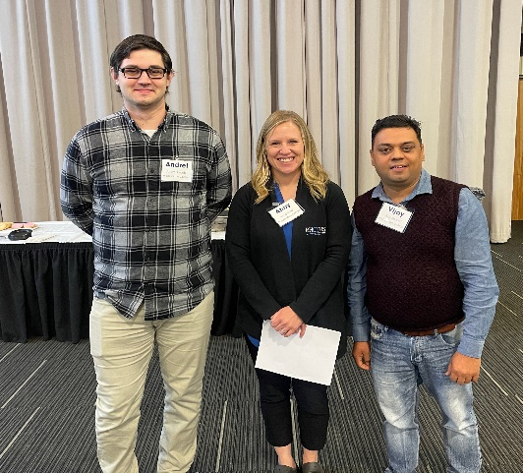
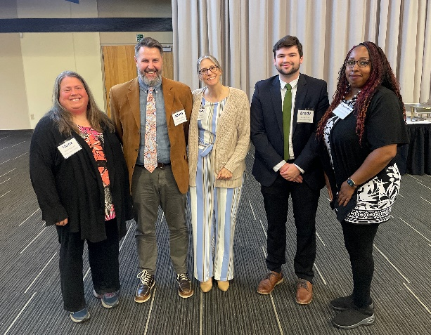
PIPE Teams

Slide 16
OSCN/INTEL MATH INITIATIVE
Collaborative Faculty Efforts (Math and Technical Faculty)
Implement a dynamic approach to support and prepare students for modern technical challenges.
Develop co-curricular support components for each module within the three new course.
OSCN Math Initiative Team
Erik Agard- CSCC
Chris Dennis- CSCC
Patricia Duty- COTC
Kyle Fulton- COTC
Greg Mlynar- LCCC
Adele Wright- CSCC
Facilitators
Chelle Younker- TSCC
Rod Null- RSC

Slide 17
Marketing Collaboration

Slide 18
Professional Development

Slide 19
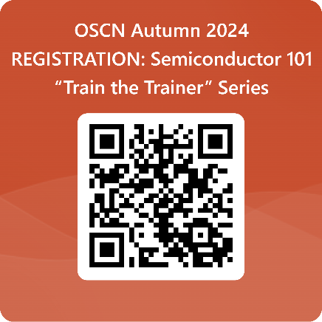
OSCN Educator Preparation | “Train the Trainer”
Semiconductor 101, FRIDAY SESSIONS
THREE WEBINARS, 3-4 PM: October 11, 2024  October 18, 2024  October 25, 2024 MERIT 1-Day Experiential Tour, 10 AM-3 PM with lunch: Lorain County Community College campus, November 1, 2024
Registration Link https://forms.office.com/r/ZJEWrBVGTm

Slide 20
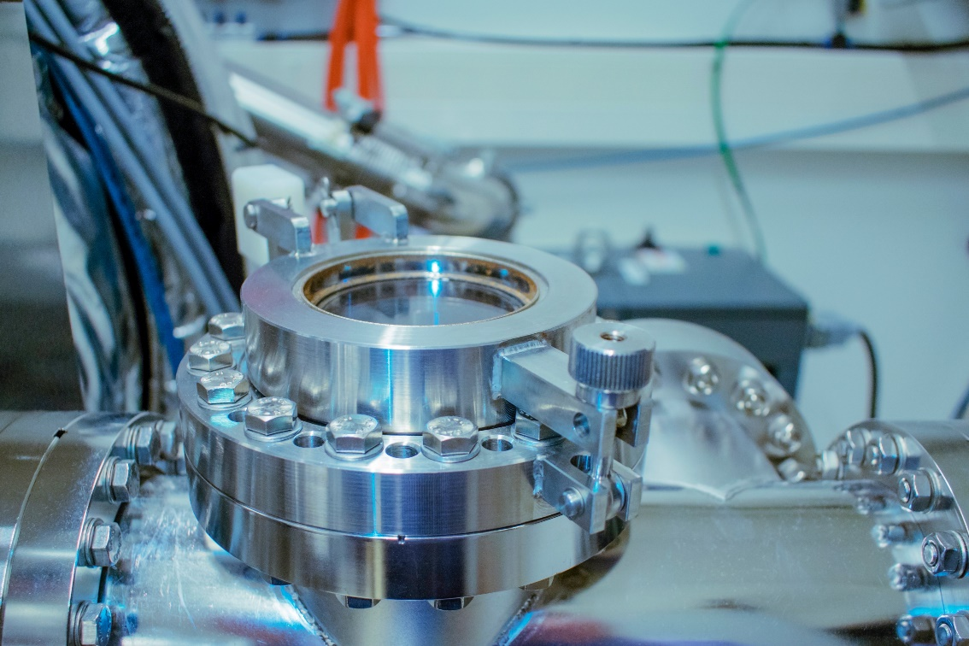
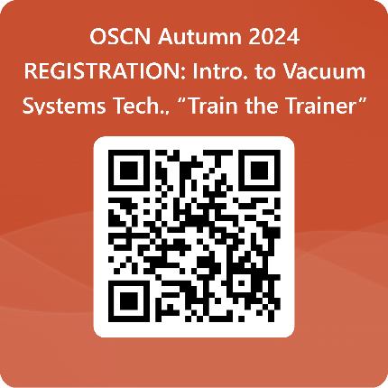
OSCN Educator Preparation | “Train the Trainer”
Introduction to Vacuum Systems Technology, FRIDAY SESSIONS
TWO WEBINARS, 11:30 AM - 1 PM: October 18, 2024  October 25, 2024 TWO Sessions, 9 AM-3:30 PM with lunch: Columbus State Community College campus November 8, 2024  November 15, 2024
Registration Link https://forms.office.com/r/zyNyWQ3UNa

Slide 21
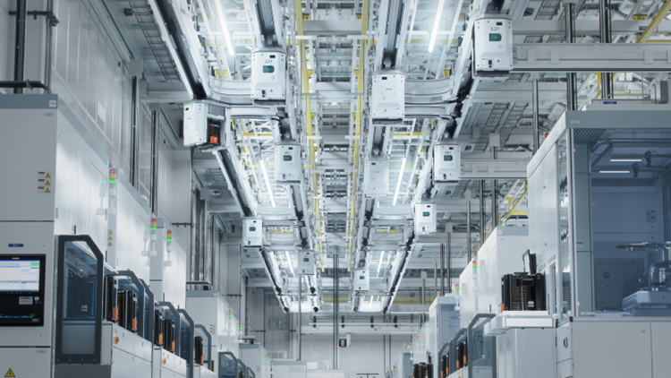
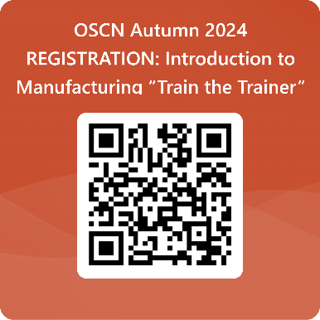
OSCN Educator Preparation | “Train the Trainer”
Introduction to Manufacturing, FRIDAYS: 10:00 AM – 11:00 AM
WEBINARS: October 11, 2024  October 18, 2024  November 1, 2024
Registration Link https://forms.office.com/r/kKe6YDQFCu

Slide 22
Community of Practice Symposium
Key Topic 2: Professional Development
In-person Community of Practice Symposium for Advanced Manufacturing and Semiconductor and Related Programming
When: November 22, 2024, from10am-2pm
Where: The Idea Foundry
Who is invited: Instructional Teams
What you need to know about the Symposium:
Community Colleges may receive $2,500 for sending professionals to participate.
Opportunity to network with professionals from community colleges, universities, and career technical centers.
Connect with employers, vendors, and other projects leaders.

Slide 23
Community Colleges 3.0 Focuses on Equitable Post-Completion Success For Students
COMMUNITY COLLEGE
1.0
COMMUNITY COLLEGE
2.0
COMMUNITY COLLEGE
3.0
Post-College Success
Completion
Completion
Access
Access
Access
Notes:
If we are going to achieve the mission of community colleges, we must start with the end in mind: post-graduation success.
There are still inequities in access and completion, and these areas still need our focus, but we must ensure that what students complete prepares them for post-graduation success.
The two areas we will address in this session are the two places all our students go: into the workforce or transferring to get a bachelor’s degree.

