Slide 1
Beyond Career Day: Empowering Future Leaders through Innovative Career Exploration Experiences
Tasha Werry, Building Bridges to Careers; Rural
David Giesige, Greater Cleveland Career Consortium; Urban
Kristy Fairfax and Nicole Will, Learn to Earn Dayton; Suburban

Slide 2
What we have in common
1. Coordinate, not duplicate
2. Leverage interest and aptitude data
3. Systems thinking

Slide 3
BB2C: What do we do?
Goal: Bridge the gap between education and employment
Mission: BB2C fosters school, business, and community relationships to inspire career choice through experience, entrepreneurship, and education.
Vision: Successful Students, Prosperous Businesses, Thriving Communities

Slide 4
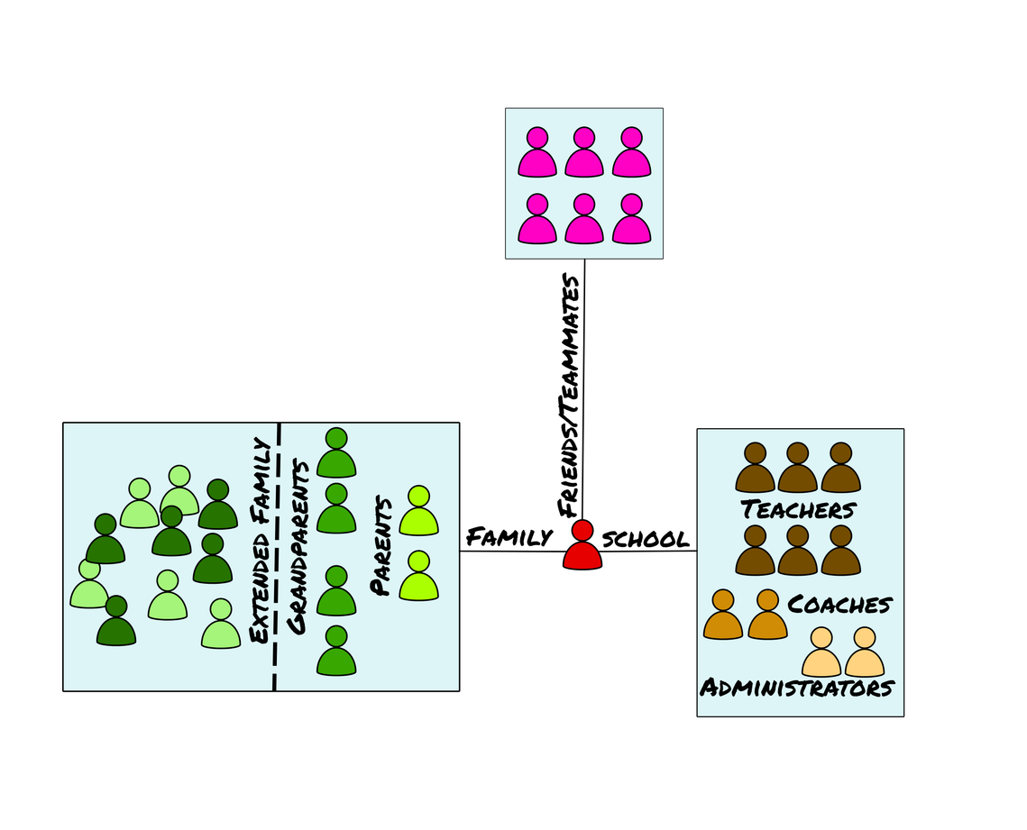
Why?

Slide 5
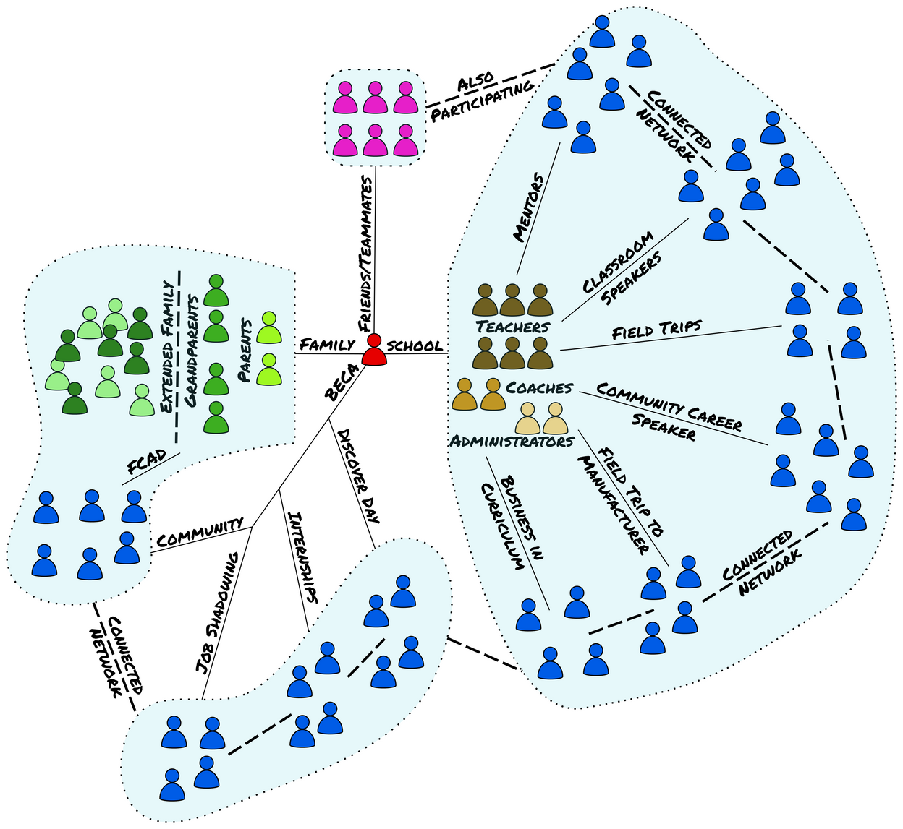
How: Community and Career Connected Learning
Systems Thinking: Break down the silos

Slide 6
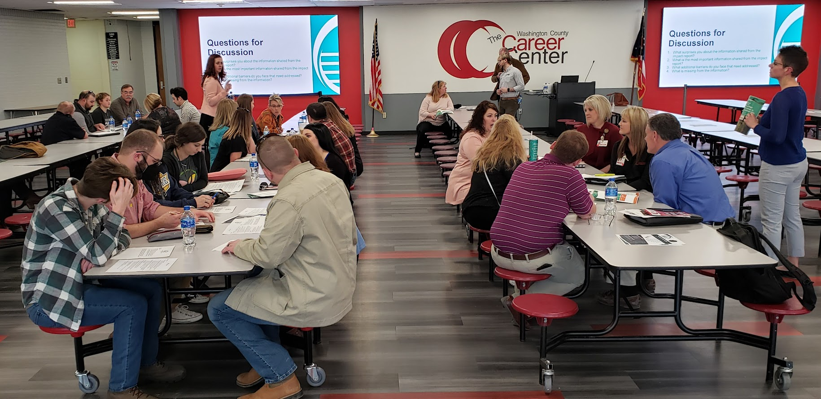
Coordinate, not duplicate
Organizations/Districts: Liaisons, BAC, shared positions, annual meetings…
Events: County-wide, led by business, school, BB2C, and others
Programs: add capacity to those that exist, provide them where they are missing

Slide 7
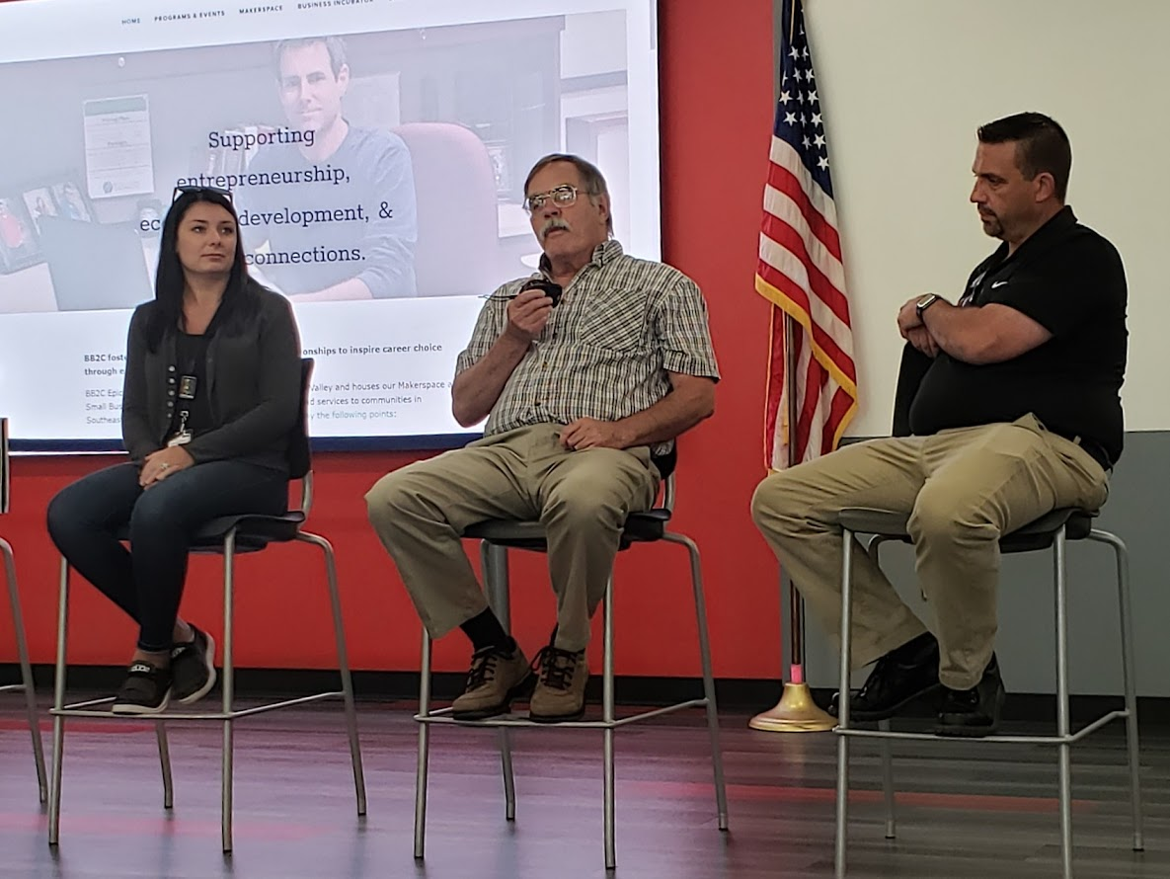
Leveraging Data (thinking systematically)
District participation data: What percent of students are gaining experience?
Local economy data: What does our employment landscape actually look like?
Interest and aptitude data: Are we providing experiences based on student needs?

Slide 8
Beyond Career Day

Slide 10
Partner Support to Districts
Industry & Postsecondary Education
Youth-Serving Nonprofits
GCCC Staff
System Alignment
Continuous Improvement
Start-up & Implementation Support
Notes:
PACE is only possible because of the ecosystem of support we’re able to provide to school districts
YOUTH-SERVING NONPROFITS
5 anchor nonprofits
Youth-serving nonprofit partners that specialize in career awareness, exploration, and readiness assist in creating and facilitating PACE opportunities alongside educators and employers. Main focus: in-school curriculum and advising.
INDUSTRY & POSTSECONDARY PARTNERS
Importance of employer engagement: Early investments in the future local workforce (K-12 students) to address employer pipeline challenges.
Think differently: Think about solutions at a systems-level that support regional economic development.
Work differently:
Help align the career-readiness curriculum to local industries’ needs
Volunteer in classrooms to talk about careers
Host work-based learning opportunities for students
WBL Strategy: focused on:
Broadening WBL: properly leveraging employer network; high-quality WBL into classroom
Building cohesive pathways: common objectives (high-wage, high-demand, high-growth industries)
Driving competency attainment: focus on intersectional in-demand competencies; positioning students (using higher ed) for credentials & certificates before end of HS
GCCC Support for PACE
System Alignment
Coordinate and align with partners across sectors
Manage in-school curriculum and WBL, centering students and employers
Continuous Improvement:
Collect, analyze, and communicate system-wide data for continuous improvement
Streamline policies/procedures/curriculum to best suit the needs of those we’re serving
Financial Support
Currently PACE comes at no cost to school districts
While our partners continue to fundraise for themselves, we currently manage 2 ARPA awards to help this work move forward and supplement our partners’ fundraising efforts (though the bulk of our fundraising is for operations).

Slide 11
WBL Strategy

Slide 12
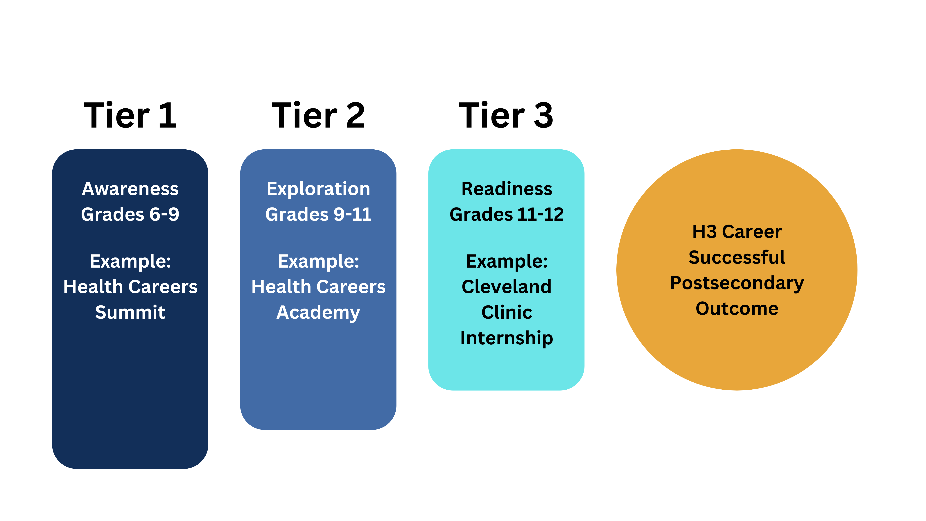
WBL Strategy

Slide 13
Notes:
HOW County can help:
Add more host sites within county
Help GCCC connect to those doing the work/employers – become an ambassador for GCCC (shape the messaging)
Offer feedback re: whether we’re directionally correct (active rep on LC)
Future funding

Slide 14
Pathways for Accelerated College and Career Experience
Beyond Career Day

Slide 15
PACCE Theory of Change
IF PACCE enables school districts to expand career exposure and experiences and
IF PACCE guides students to help them make academic pathway decisions that align with their interests and aptitudes,
THEN students will be more successful in completing postsecondary programs allowing them to achieve career aspirations and obtain high-quality employment.
PACCE IMPLEMENTS....
YouScience Assessments
Mapped CTE, AB/IB, and CCP pathways aligned with industry sectors.
A workforce Navigator Role
A student and family communication strategy
College transition advisors
PD for teachers in PACCE district supporting career-connected learning & guidance
CCP courses available at HS or online with cohort of peers at HS building
LEADING TO....
All YouScience results are reviewed with students and parents
Focused career-connected activities including field trips, lunch-and-learns, job shadows, career fairs, career lessons
Individual college and career plan for all students in district
Increased number of students in CCP pathway courses and increased number of college credits earned in HS that count toward a degree
1:1 career counseling for students in targeted group and those referred to navigator
RESULTING IN THE SHORT TERM...
with a targeted student group comparing favorably to CTE/AP/IB students for absenteeism rates, GPA, and graduation rates and students overall develop the knowledge, skills, and confidence to pursue their career interests.
ULTIMATELY RESULTING IN...
the targeted student group comparing favorably to CTE/AP/IB students for postsecondary enrollment and completion rates AND PACCE district students attain high-quality employment upon postsecondary credential or degree completion in a field related to their interests and aptitudes and increasing the intellectual and human capital in Ohio enabling the state to compete for the jobs of the future.
Intended Impact: Increase the number of students graduating from PACCE school districts who attend and complete postsecondary programs within 6 years of high school graduation.
PACCE benefits all students in a district; however, the targeted group referred to above for 1:1 counseling and identified for CCP pathway participation are specifically those “missing in the middle” students who are not currently engaged in a CTE pathway or AP/IB academic plan of study. PACCE districts may further define their targeted group to meet specific needs and gaps within their district.
Notes:
As we’ve worked with the technical assistance providers through our pilot opportunity with the Gates Foundation we’ve really worked to define the program. This is our theory of change that we have built the program around. This is the foundation for PACCE and drives how it is implemented in our districts

Slide 16
Exploring
Focusing
Preparing
PACCE Progressive Triage
6th-8th Grade
9th Grade
10th Grade
11th Grade
12th Grade
Review/update ICCP (10th)
Apply for CTE pathways
Career connected activities
Update ICCP
Outreach to parents and students
Career connected activities
Update ICCP
Complete FAFSA
Career awareness and exploration activities
YouScience Assessment (8th grade)
Outreach to parents and students of pathway options
Career awareness and exploration activities
Develop an ICCP/Student Success Plan (9th grade)
Student engagement through PACCE may be best understood as a progressive triage – while all students benefit from several elements of the program from 6th through 12th grade, some students self-select or are referred to the aspects of the program that best serve their needs.
Targeted outreach based on referrals and to list of students not specializing in CTE or AP/IB
Targeted career-related experiences using YouScience assessment and referrals
Ongoing targeted outreach
Targeted career-related experiences using YouScience assessment and referrals
Students may be referred for 1:1 counseling from navigator
May start to earn CCP credits based on relevant pathways
1:1 Counseling from Navigator for those targeted for HS CCP Pathway
1:1 counseling from navigator & college transition advisor
Earn CCP credits in pathway
Career-connected experiences related to pathway
All Students 6-12th Grades
Targeted Subset 9-12th Grades
PACCE Cohort
(10th-12th grades)
Notes:
We view our program as a progressive triage. All students within a district gain benefit with some

Slide 17
Approach
DISTRICT CULTURE
PACCE relies on committed leadership, cross-departmental collaboration, professional development, and consistent data and impact tracking to enable systems change. Navigators drive internal communications and lead district teams to enhance their impact.
SETTING A FOUNDATION
PACCE Starts in K-5 schools in our districts with career exposure opportunities. It continues into middle and high school with a more targeted focus on exploration and experiences coordinated by the navigator.
Navigating Beyond the Career Fair
INTEREST & APTITUDE ASSESSMENT
Interest and aptitude assessment give the navigator insight into whole district trends as well as helps match students with career experiences. It also serves as a place to start the conversation with students and help them map their individual college and career plan as well as explore career options.
The Navigator position plays a crucial role in PACCE. Having a dedicated individual in each district focusing on Careers and CCP Pathways and taking ownership of the tasks is key to progress.
CONTINUED CAREER CONNECTIONS
PACCE navigators coordinate regionally to expand career opportunities through activities like lunch-and-learns, worksite tours, and work-based learning, while developing monthly career-focused lesson plans to keep career connections a priority in the district.
1:1 NAVIGATION FOR CCP PATHWAYS
Our navigators work 1:1 with students that are participating in CCP Pathways. They also work alongside transition advisors from Sinclair College

Slide 18
Systemized Career Culture
Significant support from district and building leadership
Built into district strategic plan
Dedicated Professional Development
Firebirds in the Field
Monthly Career/Workforce Advisory meetings
Dedicated communication from district and building leadership to staff, families, community
Leveraging Interest/Aptitude
Monthly District Career Focus and Career Days
Elementary - career posters and weekly announcements
Middle School - weekly career activity and monthly lunch and learn
High School - weekly career activity and monthly field trip
YouScience (MS and HS) guides FT and programming
HS Course Pathway guides
CTC and other programming
Coordinate not Duplicate
Mont. Co ESC Business Advisory Council
Biweekly Navigator meetings
Partnership with Sinclair College
Quarterly Career Champion meetings

Slide 19
Questions?
Tasha Werry, BB2C: twerry@bb2careers.org
David Giesige, GCCC: dgiesige@greaterclecc.org
Kristy Fairfax and Nicole Will, L2ED: kristy@kmfworkforce.com; nicole.will@ketteringschools.org

